Slide 1







Taking your Power Apps mobile navigation UI to the next level

Slide 2

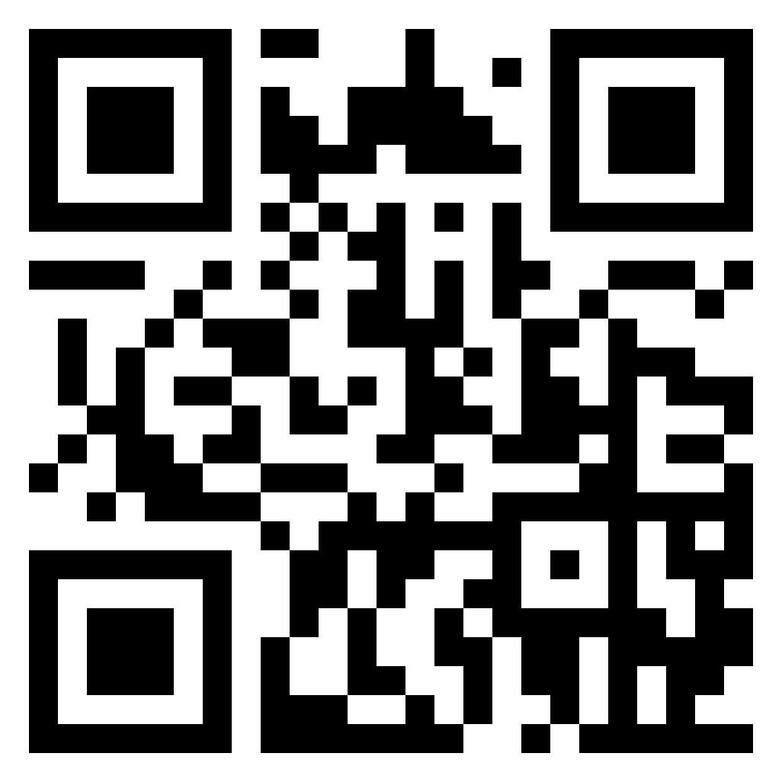
About me
13x Microsoft Certified Professional in Azure, Power Platform and M365
UX/UI obsessed
Active community contributor
Blogger
Avid gamer and dog mum
Principal Technical Consultant
Computacenter
London, UK

Slide 3
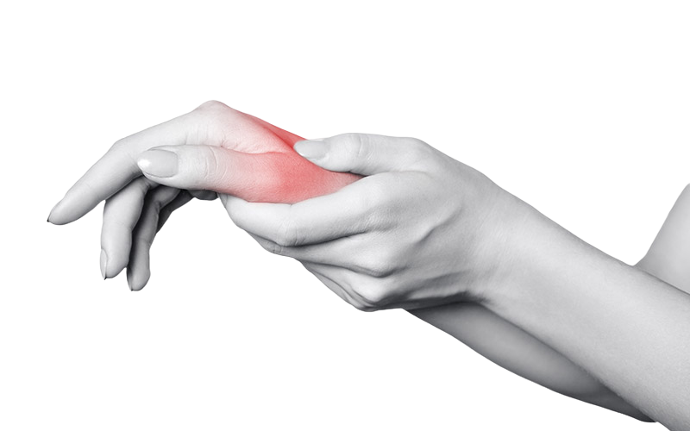
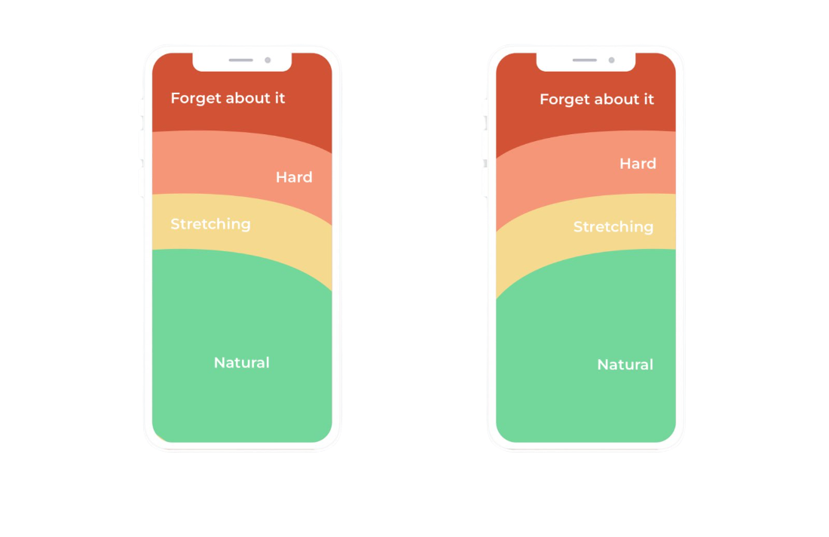
Let’s talk about the thumb zone
Left hand
Right hand

Slide 4



Why is mobile navigation important?
Accessibility
User experience
It looks awesome!
Make it easy for those using assistive features and software to navigate around your application
Rapidly access key screens in your application
And if it looks good… your users will LOVE your app!

Slide 5



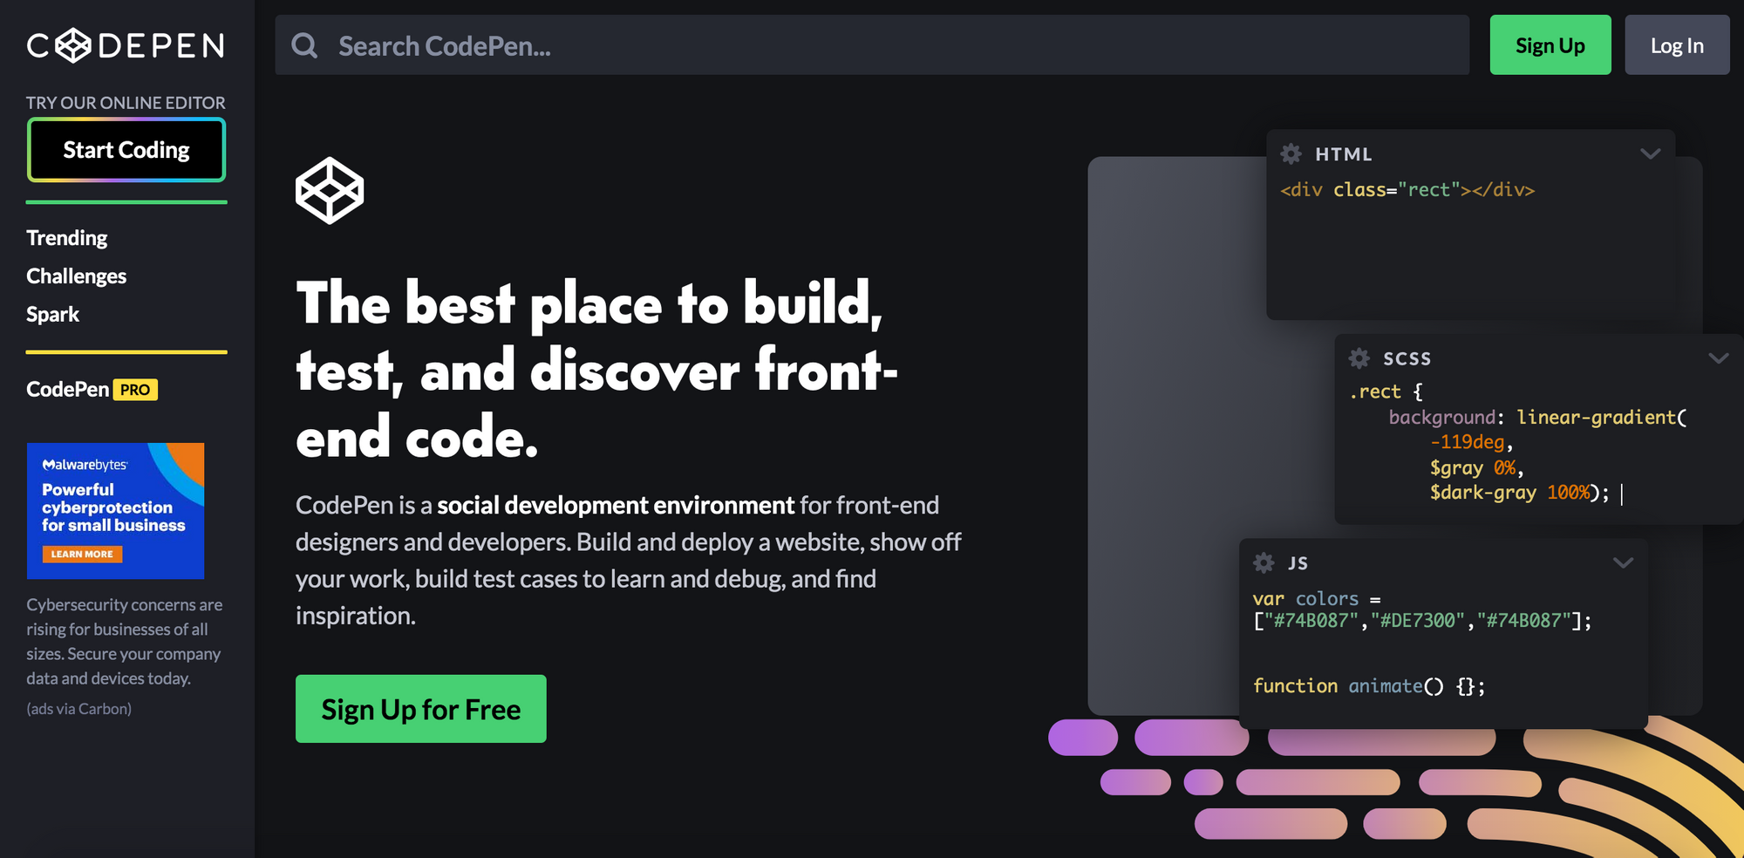
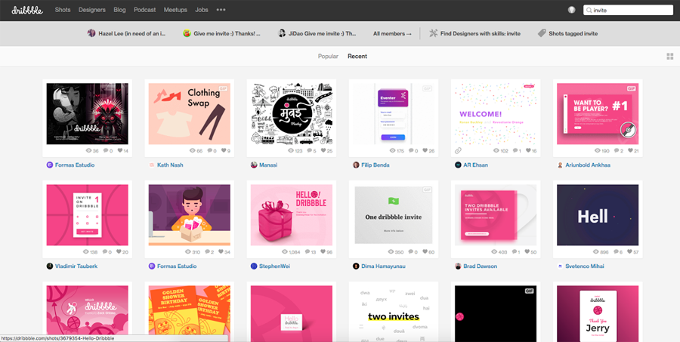
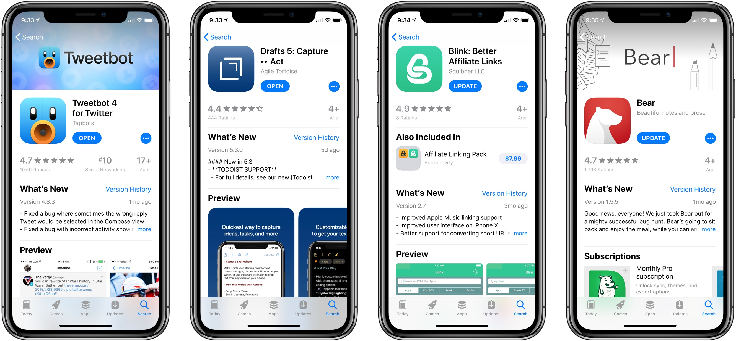
‘But I’m not a UI designer...’
Get inspired!
Codepen.io
Dribbble.com
Your own mobile!

Slide 6

Demo time!

